Slide 1
3D Mesh Labeling: A Data Driven Approach
Rohit Rao P
111447392

Slide 2
Overview
Mesh Labeling and its application
Methods to describe a mesh
Paper 1: Learning 3D Mesh Segmentation and Labeling Evangelos Kalogerakis et al
CRF Model for segmentation.
Unary and pairwise energy terms.
Joint Boost classifier
Paper 2: 3D Mesh Labelling via Deep Convolutional Neural Networks Kan Gao et al
Geometric Feature Extraction.
Network training and parameter estimation.
Mesh Label Optimization.

Slide 3
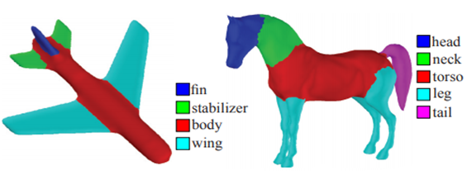
Mesh Labeling
Given a 3D mesh
Mesh Segmentation
Labeling
Identify the probable object part that each triangle on the mesh belongs to.
Application
Mesh editing.
Deformation
Modelling
Style transfer

Slide 4
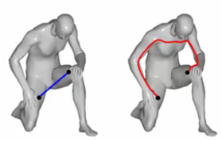
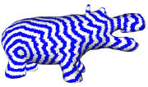
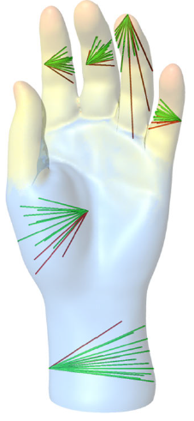

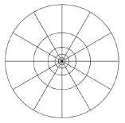
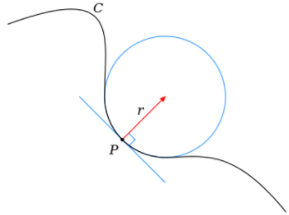
Mesh Features
Geodesic Distance
Shape Diameter function
Shape context
Curvature

Slide 5


Learning 3D Mesh Segmentation and Labeling : CRF Model for segmentation.
Minimize the objective function
Find Model Parameters

Slide 6
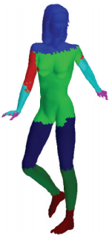
Unary Energy component
Most important component of the algorithm.
Evaluates a classifier(Joint Boost classifier).
Excellent result in the segment interior but poor results at the boundary.

Slide 7

Pair Wise energy Component
Label Compatibility term L:
Low penalty for compatible labels like head and ear.
High penalty for incompatible labels like head and leg.
Geometry dependent term T:
Probability for two adjacent faces not having same label
Penalty proportional to dihedral angle(w)
Penalty proportional to boundary length (u)

Slide 8
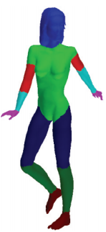
Unary and pairwise energy components
Using both unary and
pair wise components.
Using only unary component

Slide 9
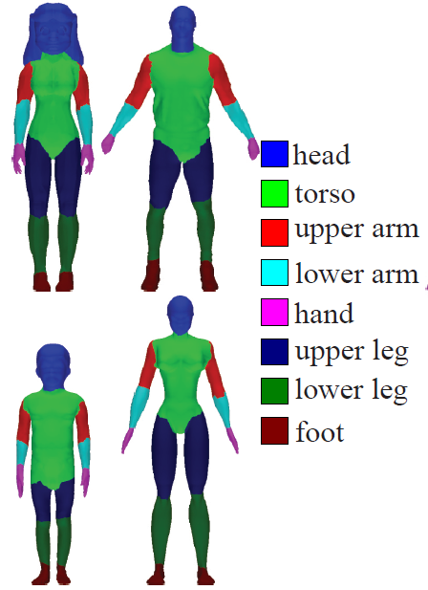


Joint Boost classifier
Decision Stump
Minimize
j is number of iteration ~ 300
I is indication function, 1 if Ci =1 and -1 otherwise
Weights are updated in each iteration

Slide 10
Problems with the method
Curse of dimensionality: Big Feature vector
339 feature vector for Unary term.
191 feature vector for Pairwise term.
Linearly stacked features.
Prone to overfitting the training data.

Slide 11
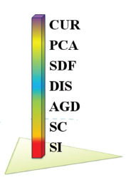
3D Mesh Labelling via Deep Convolutional Neural Networks: Geometric Feature Extraction.
Idea: Build a smaller feature vector
Effective
Robust
Using convolution operations in CNN features are
Combined nonlinearly.
Hierarchically compressed to have smaller dimension.
600 components to 30 × 20 feature matrix.

Slide 12
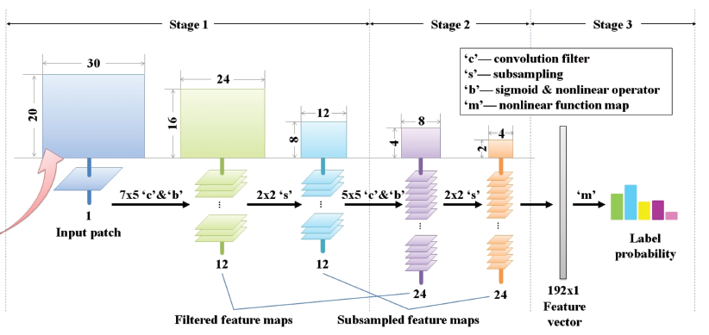
Network Structure

Slide 13
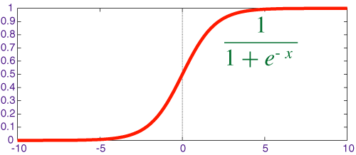

Convolution and subsampling
Stage I
Apply Twelve 7X5 convolution filters(W) and Bias (B).
Apply Sigmoid function.
Down sample by 2 to get Twelve 12x8 feature maps
Stage II
Same process as stage I but Apply twelve 5X5 convolution filter.
24 features maps of size 4x2.
Reshaped to 192 component linear vector
Stage III
P is label prediction for feature vector v
Approximate P to match ground truth G

Slide 14
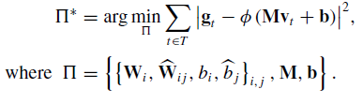

Network Training
Feed Forward
pass the input geometric features to update the label Indication.
Back propagation
Reduce prediction error by tuning parameter using gradient descent
Delta is the gradient.
Alpha is learning rate set to 0.95.

Slide 15


Mesh Label Optimization: Boundary case
Adding constraints to overcome labeling inconsistency
Term 1:
High penalty on incorrectly labeled triangle
Term2:
No penalty if same face.
Penalty proportional to Dihedra angle(theta) and distance(Phi).

Slide 16
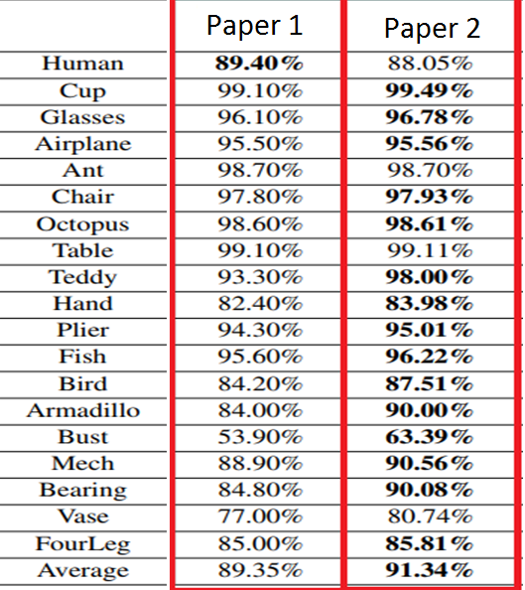
Comparison of results

Slide 17
Questions?

